Slide 1
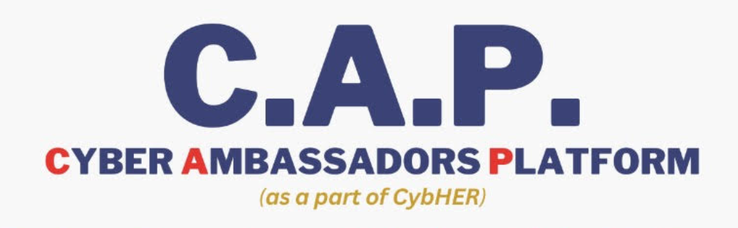
MENTOR TEACHERS & VPO/SHE Team officers ,Nodal officers and DCO, and GCDOs ORIENTATION ON
Dr Anuradha Tatta
CAP Project Coordinator
WSW, Telangana.

Slide 2
Introduction
CAP (Cyber Ambassador Platform) is an initiative started by WSW Telangana police dept in coordination with Education department in a vision to bring about awareness in school students regarding safe and secured cyber practices and there by preventing Cyber crimes in the most vulnerable group of citizens.

Slide 3
Law enforcement,
(WSW, Telangana police dept)and NGO Partners: Strategizing, planning, course material development, implementation, assessment, outreach activities, data analysis and report making.
Education Department,
Providing details of target population, implementation of course in the schools among the selected students
Cyber secura digital app developers ,
Content development and technical support.

Slide 4
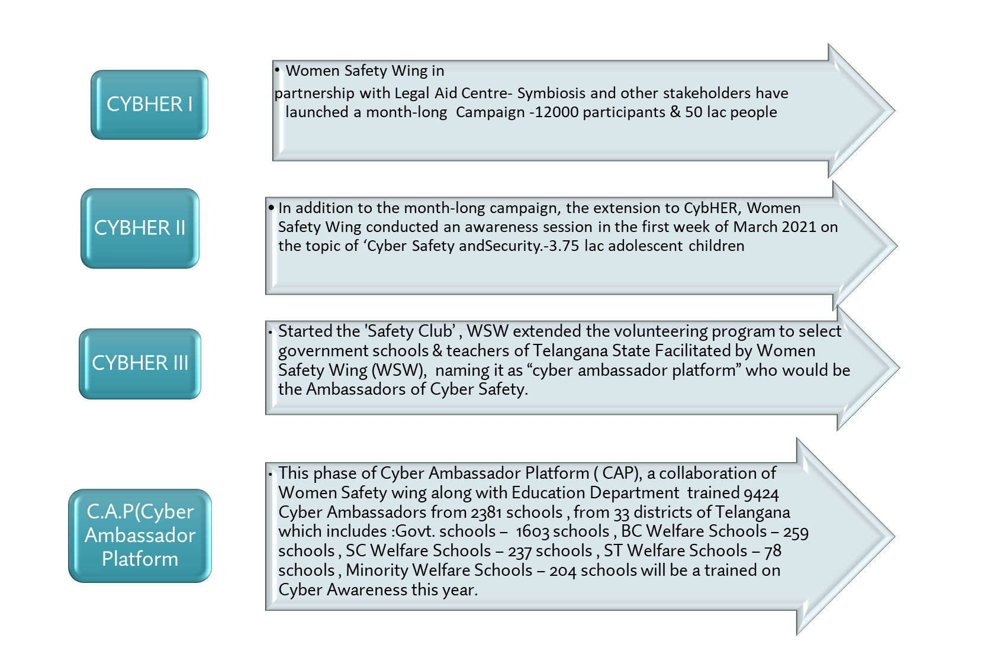

Slide 5
This phase of Cyber Ambassador Platform ( CAP), a collaboration of Women Safety wing along with Education Department will train around 8542 Cyber Ambassadors from 2133 Govt. schools from 33 districts of Telangana .
CAP PHASE III

Slide 6
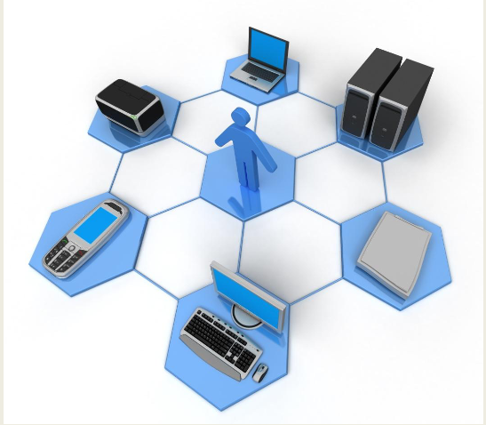
The need for C.A.P III

Slide 7
New version of CAP
Providing the students with an app-based learning and its easy adaptability.
Multi time access to the content thus enabling the students learn at their own pace.
Automated attendance and progress tracking for each and every student.
Capturing and retrieving of learned subject.
Expandability or scalability of targeted group along with updated content.
User-Friendly LMS application.
Enables easy monitoring and evaluating the impact of the CAP on schools and students, identifying areas for enhancement and further expansion.
Host events and competitions, such as security challenges, to actively involve students and encourage their development through activities.
Child-Friendly online Content (e.g., animated videos, comics, and infographics). that enhances active engagement of the students throughout the training.
Guards against the risk of content distortion.
Offers Content in Multiple Languages.

Slide 8



Objectives
Objective 01
Intervene in the Rural parts of Telangana and educate the people on Cyber
safety.
Objective 02
Increase the awareness on online safety among adolescent children.
Objective 03
Facilitate discussions among adolescent children in order to identify challenges
and opportunities as well as sharing experiences on building trust and
security in the digital world for sustainable develepoment.
Objective 04
Create a pool of young and well aware cyber ambassadors from each school who will act as a catalyst in spreading awareness on Cyber Safety to their
immediate communities
Cyber Ambassador Program

Slide 9
New version of CAP
Mode of implementation
Content development
Objectives
Process of implementation: Framework of training, the stake holders training ,
Workflow and milestones
Roadblocks and Challenges
Solutions
Investiture ceremony

Slide 10


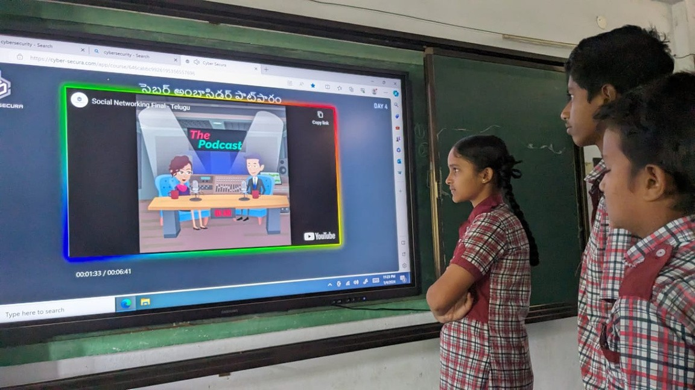
CAP III
Cyber Ambassador Platform Program (CAP) is a training program with selected students from selected schools, each school with two teachers and 4 students where the team is empowered to handle the online threats to children and also promote the positive use of internet and mobile.
There is a need to re orient educational and training systems in a rapidly changing world to inculcate life skills, moral and ethical values among the students so that they become tech savvy and not tech slaves.
Hence, we have brought up a five day course in CAP Phase III on digital mode which describes fundamental measures that should be observed to maintain the health of the system as well as protect the user from any malicious online activity.

Slide 11
FRAME WORK OF C.A.P
Cyber Ambassadors | 4 PER SCHOOL
Mentor Teachers | 2 PER SCHOOL
Total No of districts (C.A.P) | 33
No of schools in C.A.P program | 2133
Total No of Mentor Teachers | 4266
Total No of Cyber Ambassadors | 8542
Total No of mobile devices used from each school | 2 mobiles and 1 extra

Slide 12
FRAME WORK OF C.A.P TRAINING
Days the sessions run | Monday, Tuesday, Wednesday, Thursday , Friday .
Total No of modules: | 5 modules in 28 levels
Timings of the session | 3.00 pm to 4.00 pm
Start date of the session | 27th JANUARY
Training ends on | March 30th 2024
Activities schedule(Investiture ceremony): | Shall continue till April 2024

Slide 13


COURSE DETAILS
The course is designed in a fun, interactive manner to allow children to engage and assimilate the material easily.
The course is covered over the span of five days and 28 levels where the student learns through captivating videos, infographics, comic strips.
In this course, the cyber ambassador will learn about:
Cyber Hygiene Netiquettes Cyber addiction Online predators
Child online activity protection Cyber Stalking
Email and password threats Credit card scams
Phishing Mobile security
Social networking
Impact on physical and mental health

Slide 14





COURSE STRUCTURE
DAY ONE
DAY TWO
DAY THREE
DAY FOUR
DAY FIVE
Cyber Hygiene
Online Games
Email Threats
Mobile Security
Health Issues
Netiquettes wing
Cyber Addiction
Password Threats
Social Networking
Mental Issues
Online Class Etiquettes
Public Computers and WiFi
Malware and Viruses
Child Online activity Protection
Credit Card Scams
Fake Applications
Physical Issues
Cyber Space
Phishing
Desk Security
Turning off computers
Cyberstalking
Email lottery
Security Awareness
Cyber Laws - India
Women Safety
Online Grooming
Cyber Bullying

Slide 15
Roles and responsibilities of the Mentor Teacher:
Two teachers from each school will be hand holding the students of their schools.
Will ensure that they are punctual to all sessions
Completing activities in time.
Also will assist in taking it out to the other Students of the school once the training is complete.
They will moderate and ensure proper content is posted on the WEB PORTAL with a complete report duly signed by the concerning teacher.
Share the pics and videos within the timelines

Slide 16
• Teachers should communicate about the training sessions to the two children who are assigned to them.
• Monitor if the two children who are under the supervision of the teacher have attended the training and activity session. If they have not attendeded, teachers should make a note of the student’s concerns and bring it to the notice of the nodal officer along with updating it in the student profile sheet.
To coordinate with the other stake holders(village police officers under local jurisdiction, nodal officers, SHE team officers, etc.) in conducting continuous monitoring and assessing of students' work and activities such as:
• Quick feedback mechanisms post the training session
• Worksheets submission
• Teachers should also monitor the learning of their students. If in case a student does not understand a certain concept, the teacher should escalate the concern to the project coordinator.
• To coordinate with the other stakeholders ensuring active participation on the WhatsApp group created district wise

Slide 17
Role of She Team’s Officer/Village police officers (VPO) of local PS
Representing a SHE team in-charge as Admin with all Cyber monitors and teachers as members of the unit.
Village police officers/Police officers from local Police station should ensure active participation and 100% attendance of the selected four students and two teachers to the training session organized by WSW.
SHE team member or In-charge officer should inform all selected teachers and students regarding upcoming training sessions well in advance, collect report of the reason behind absenteeism of the students and teachers.
To form WhatsApp group district/commission wise with nodal teacher, SHE Team In-charge.

Slide 18
Create awareness programmes in the selected educational institutions on the Cyber related offences and how to be away from being abused of Cyber Offences.
Establishing rapport with the unit level Teachers in the selected schools, Nodal officers and see that the uninterrupted communication flow till down to the last person,
See that the queries of the selected Students, Teachers be clarified by the technical knowledge experts time to time, ensure no gap is placed between the students and the knowledge partners.
Ensure to follow of structured time table by the members of the selected schools.
Coordinating for session based activities imparted to cyber monitors every month.
Ensure availability of gadget/ to be online for all students for sessions.
. Providing platform for students selected by District Nodal officers (teacher mentor) to explain cyber safety in awareness meetings elsewhere.

Slide 19
.
Encouraging all mentors to take up proactive role in keeping spirits of monitors, enabling them to participate, seeking all clarifications etc.
Give an opportunity to the best performing students / interested students to take a part in the awareness programs on cyber related offences.
.Update the photographs and data of the activities done regularly in the relevant WhatsApp groups and social media sites.

Slide 20
Role of a Nodal Officers, DCO and GCDOs
Selection of monitors should be done in a right manner.
Each nodal officer should understand the concept of Cyber Ambassdor Platform
Creation of Whatsapp group - dissemination of content, time table
Identification of device/gadget available with students; monitor
Pre-orient all the student monitors on content
Dissemination of content, activities entrusted to monitors
Actively involve in all activities entrusted to monitors
Evaluation of utility of the session and preparing a report
Invite SHE teams to create awareness, prepare time tables and conduct the sessions in selected schools.
Identifying, Acknowledging and Appreciating best participants - students and teachers - rewarding them.

Slide 21
BENEFITS OF CYBER AMBASSADOR
Working with state police WSW
Time management.
Teamwork Skills.
Problem Solving Skills.
Management Skills.
Networking.
Knowledge of cyber security going further they can also Build the career if interested.
Recognition from the WSW of Telangana, as Cyber empowered mentor and school shall be recognized as Cyber Empowered School.

Slide 22
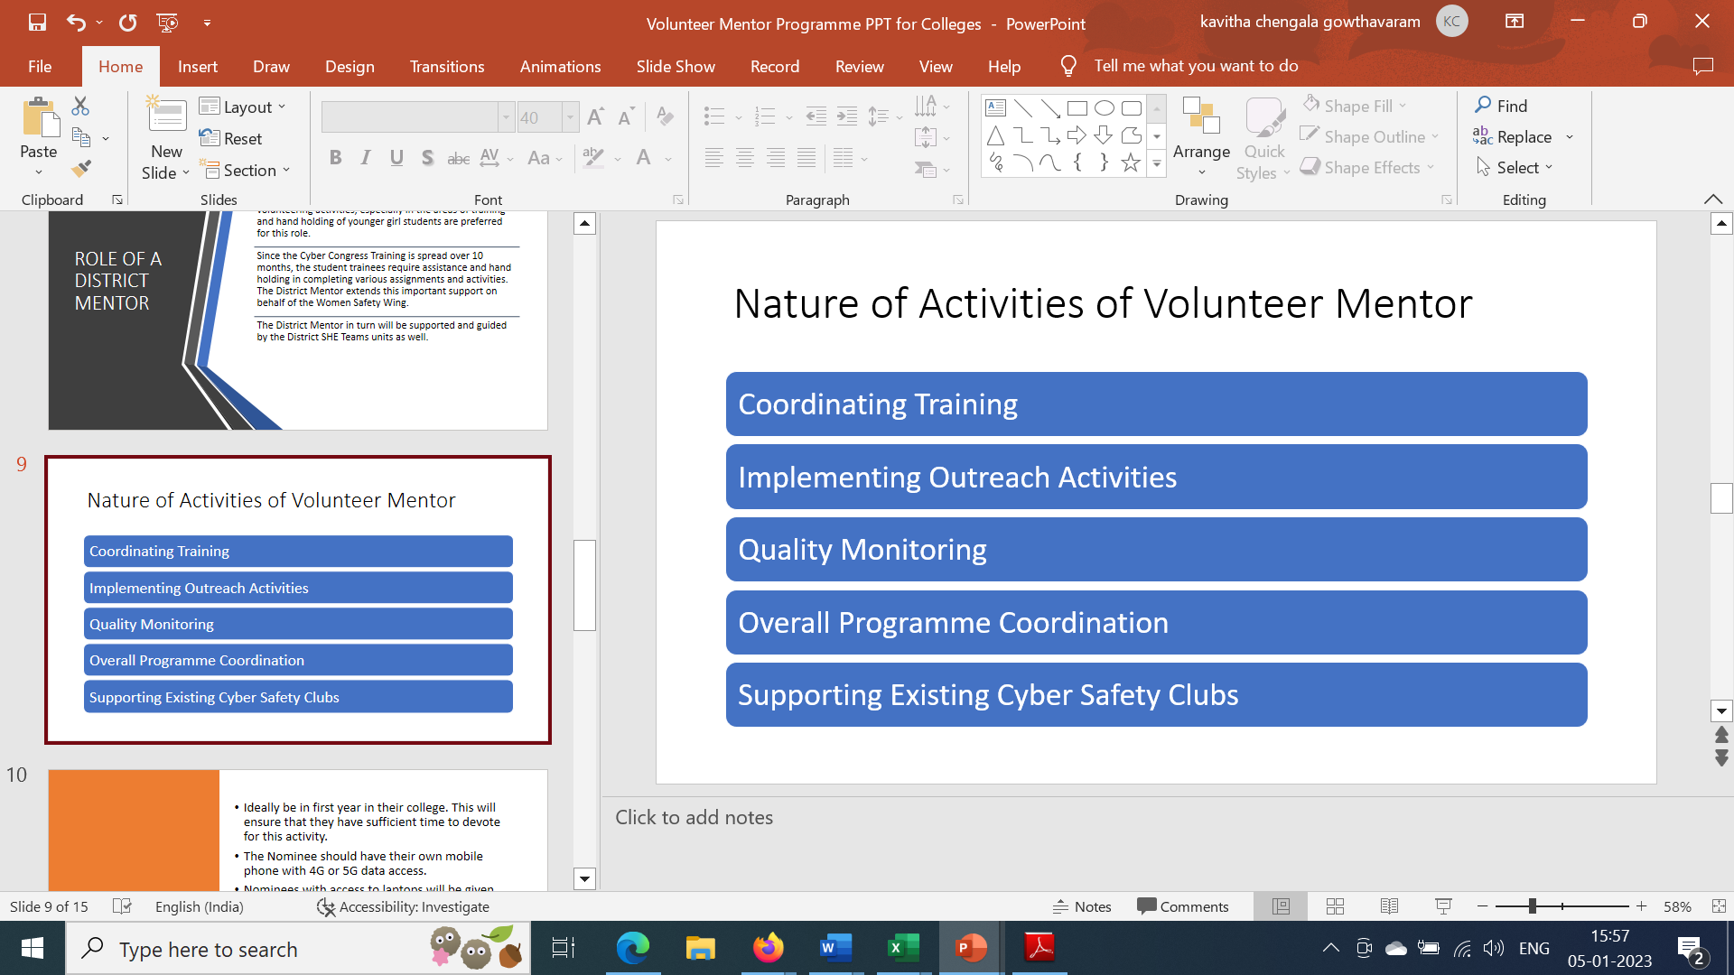
Nature of Activities of Mentor Teachers, Village police officers, SHE team officers, Dist. Coordinating officers

Slide 23

Functional workflow of Teachers & Other stakeholders in implementation of CAP phase -III in the selected 2133 government schools.
Before the Training session ;
Ensure the weblink reaches on time and students access the course content.
Check if any teachers are on leave and arrange an alternative phone for the training
c. Ensuring the activities ,pics and videos reach WSW
Support link :
https://drive.google.com/drive/folders/1XEnrETzVOm2KRORjjumsBVefRCppH9cs?usp=sharingCourse
Content link
Telugu
https://cybersecura.com/course/646cabbc9926195356557696
English
https://cyber-secura.com/course/64aa58b567884c0447ae9e24
Coupon codes
Telugu: CAPPILOT
English: CAPPILOTENGLISH
Google link to complete the activity from after completing the course
https://forms.gle/BHuDwP5HrKjq8czv8
Link to all district Whats app groups
link to all district Whats app groups

Slide 24
How to report: (video and infographic demo links in English &Telugu)
https://drive.google.com/file/d/15WlVUtdxe3WBFqCtZSeqqgC2EAHPyWm6/view?usp=sharing
https://youtu.be/TVCE7sT2Pbs
https://drive.google.com/file/d/1CEG4nFNvp06JG3sXVwF7oroQDMVUk9im/view?usp=sharing
https://drive.google.com/file/d/1CEG4nFNvp06JG3sXVwF7oroQDMVUk9im/view?usp=sharing
https://drive.google.com/file/d/1G3_SgheskjizQzJytbRl0C8Ieb7ErNKr/view?usp=sharing
https://youtu.be/2fyh9fcgZwA
https://drive.google.com/file/d/1aIbWH6KAh1fbxhOjjydOmO9u29p42H3T/view?usp=sharing
Contact us through District Whatsapp groups or reach us out:
Anuradha-7780392868
Mounika-9618085578

Slide 25
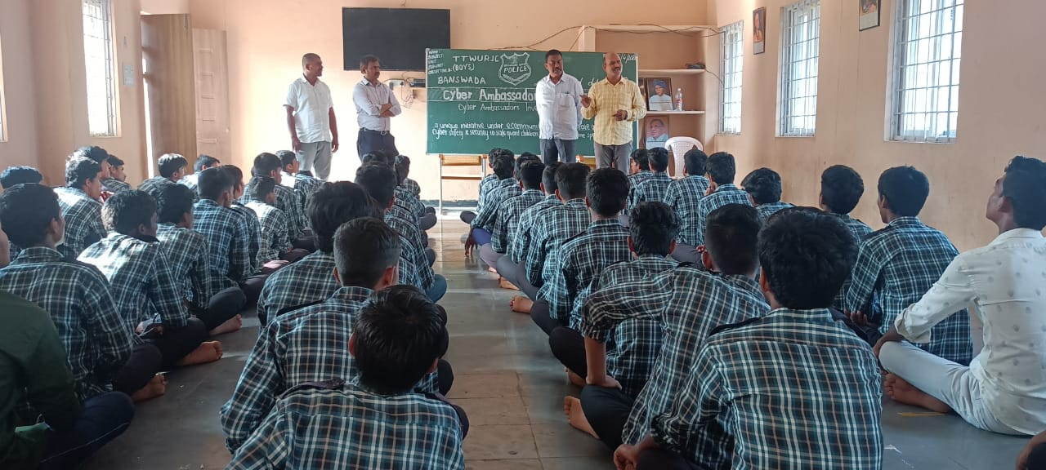

Slide 26
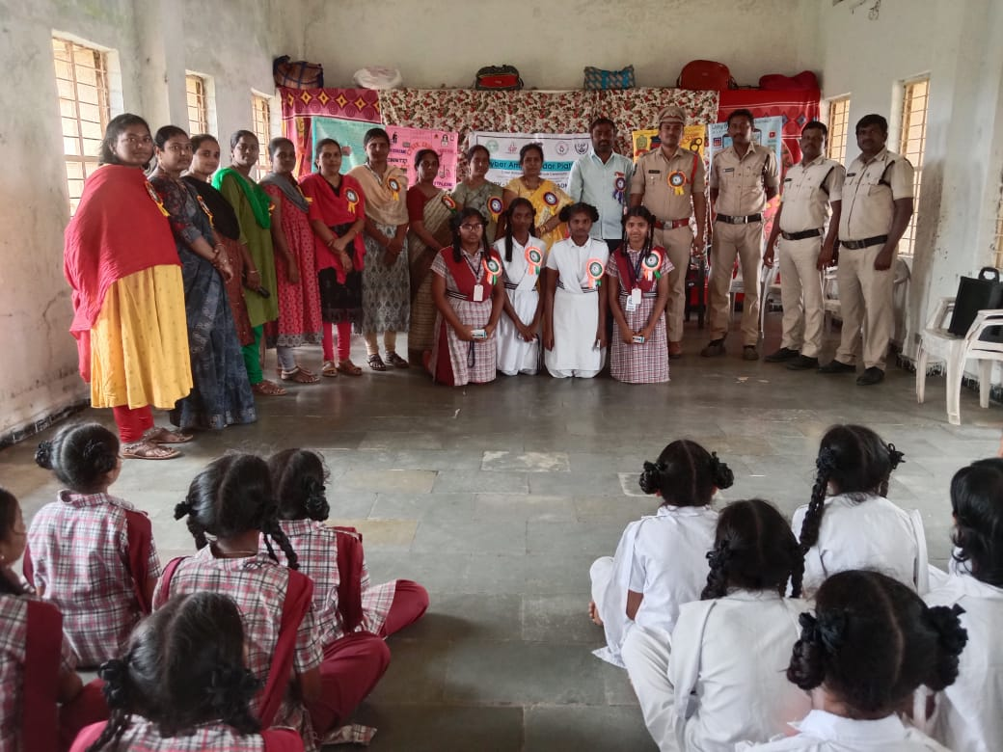

Slide 27
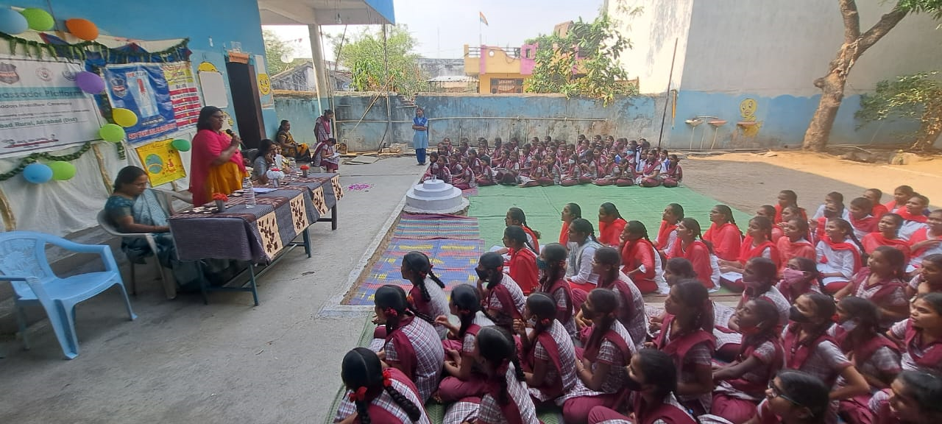

Slide 28
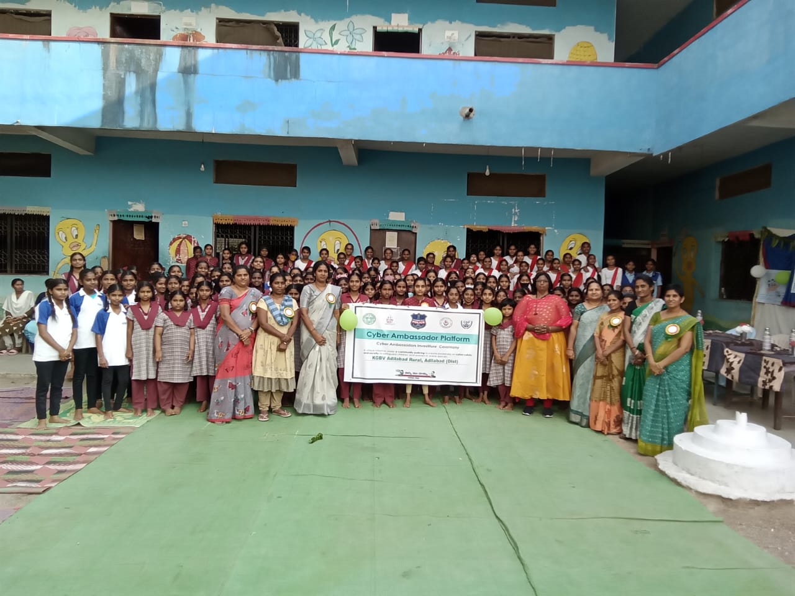

Slide 29
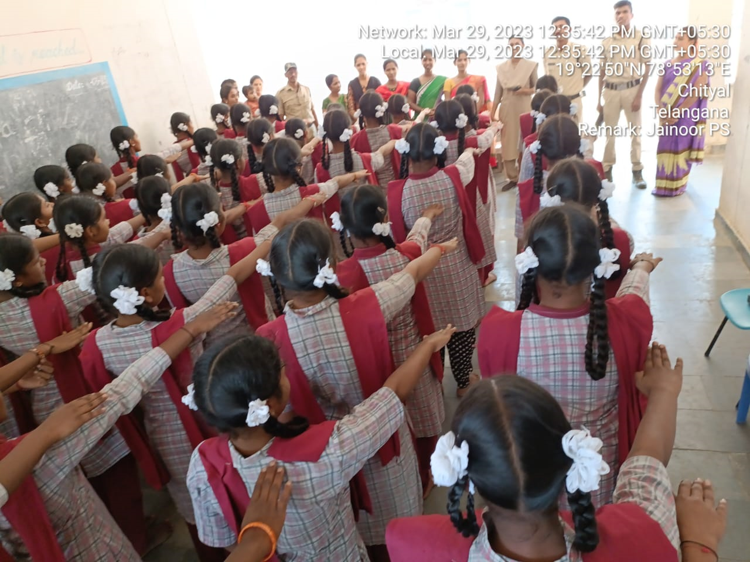

Slide 30
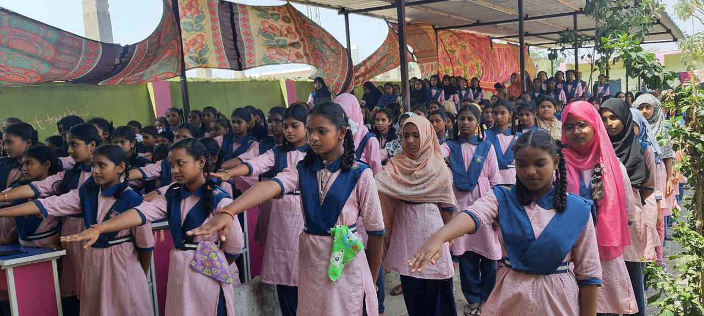

Slide 31
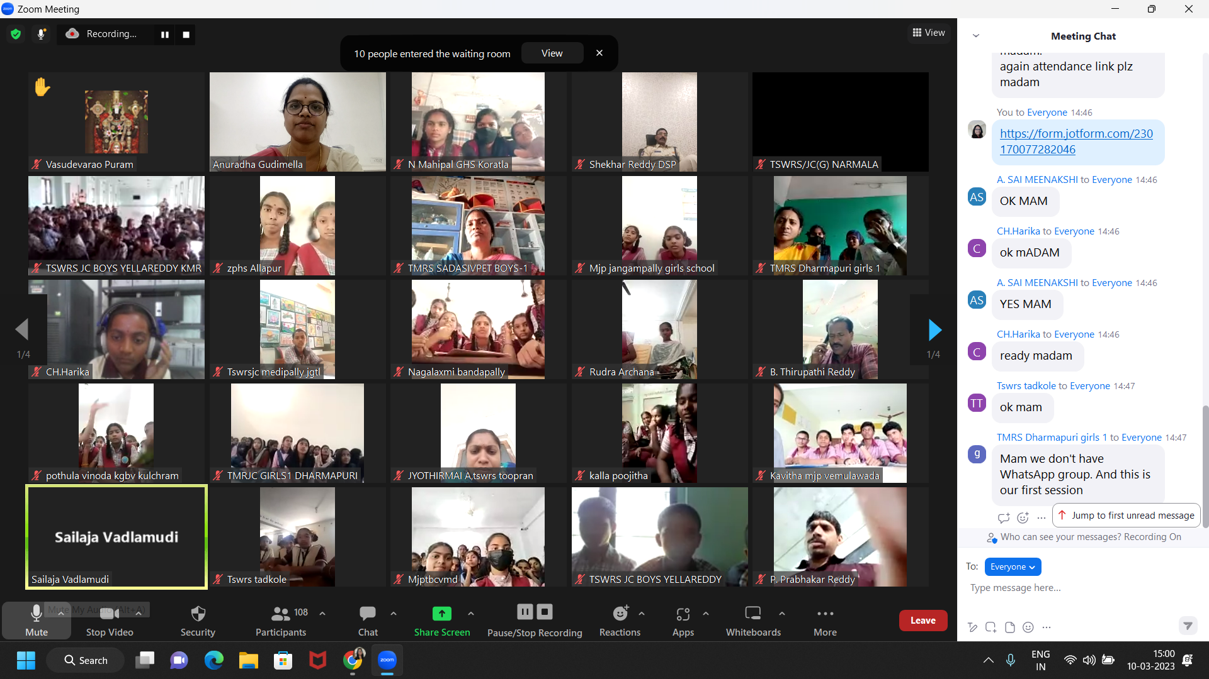

Slide 32
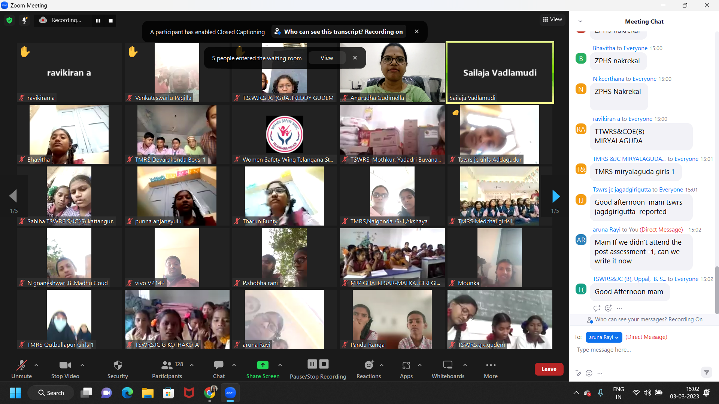

Slide 33
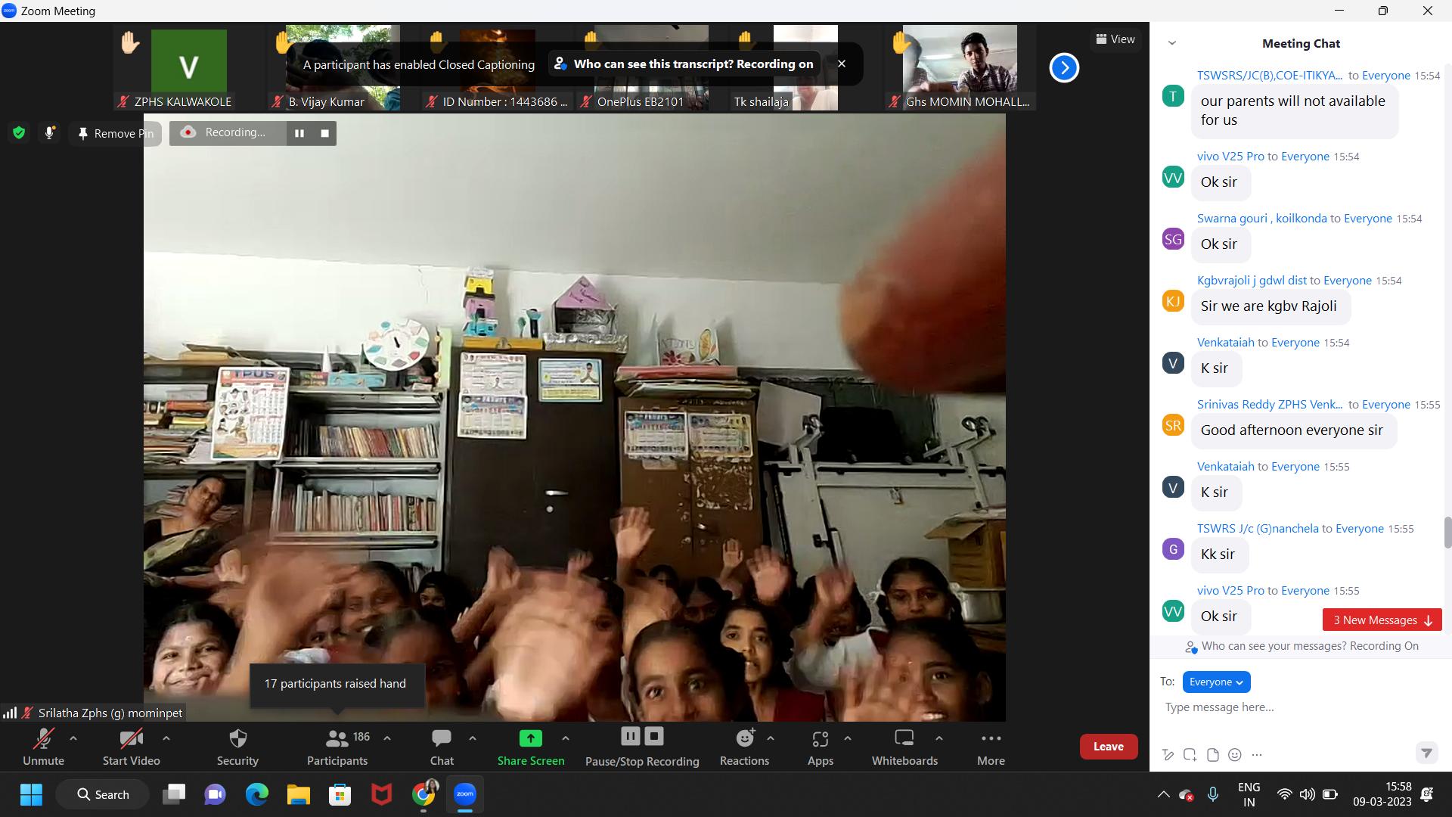
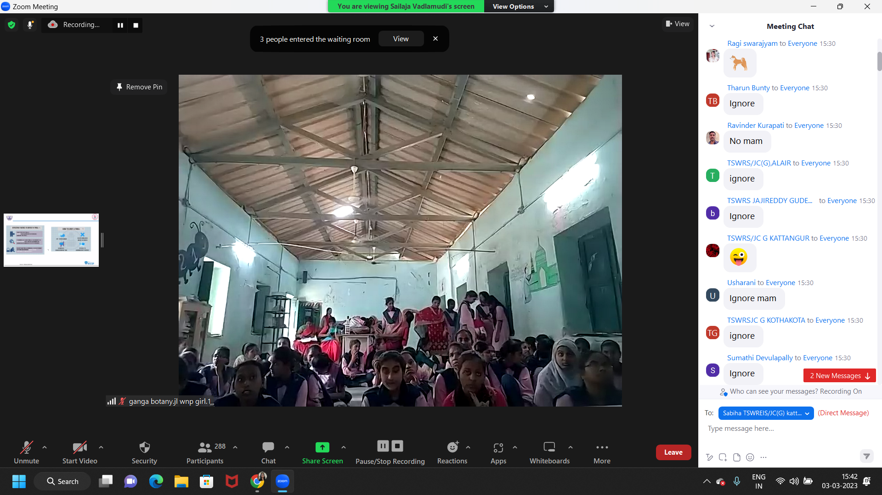

Slide 34
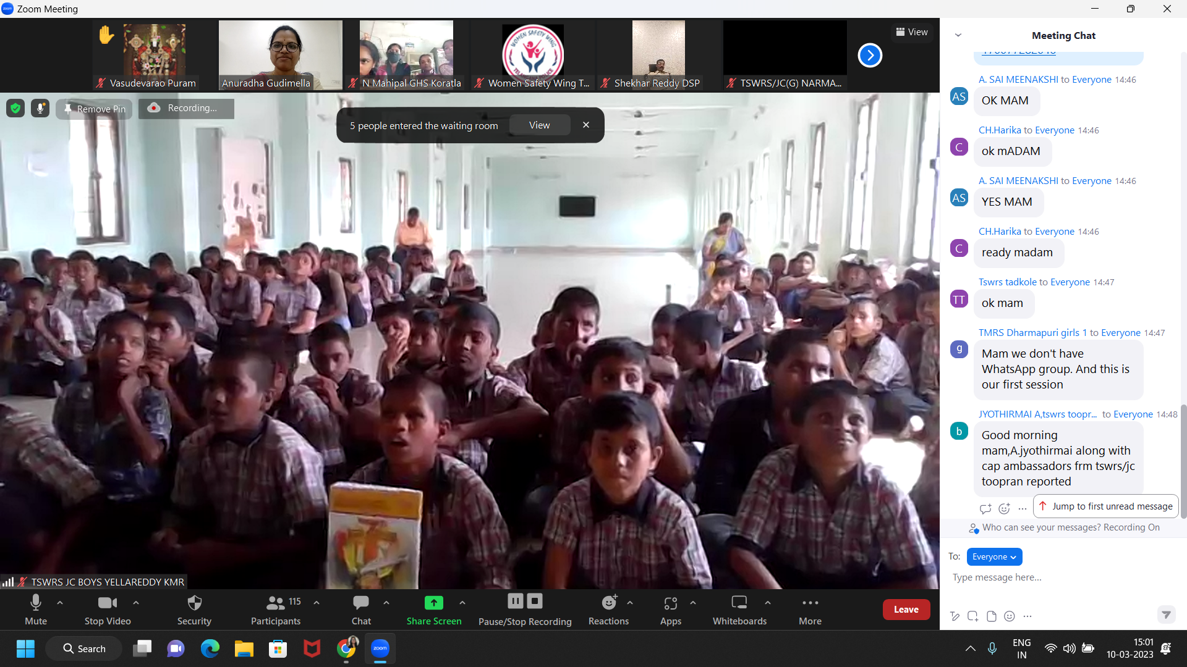

Slide 35
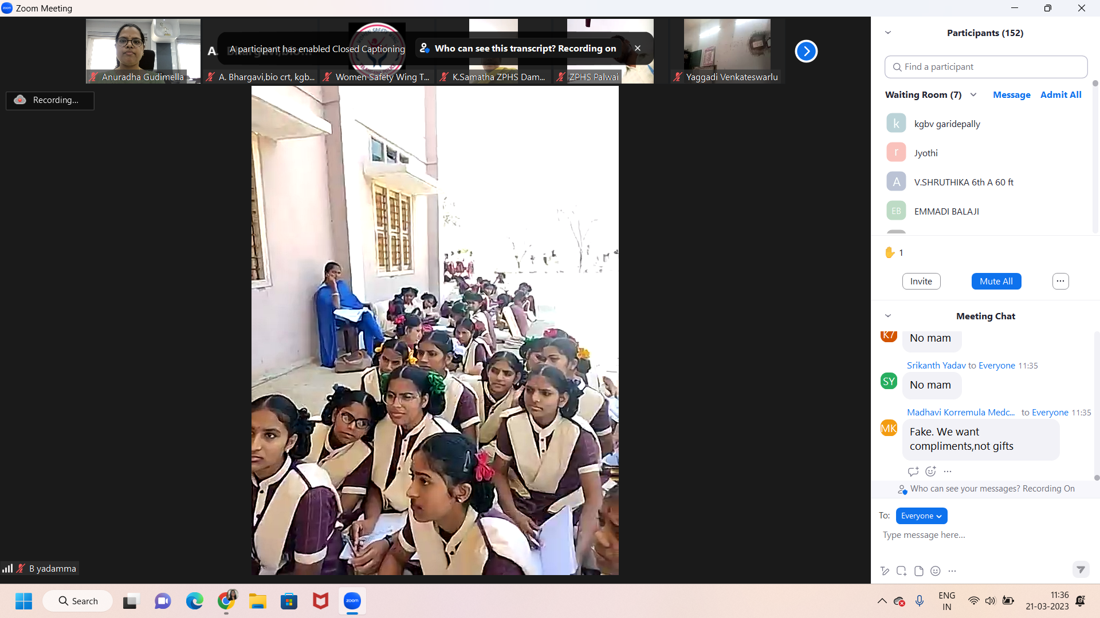

Slide 36
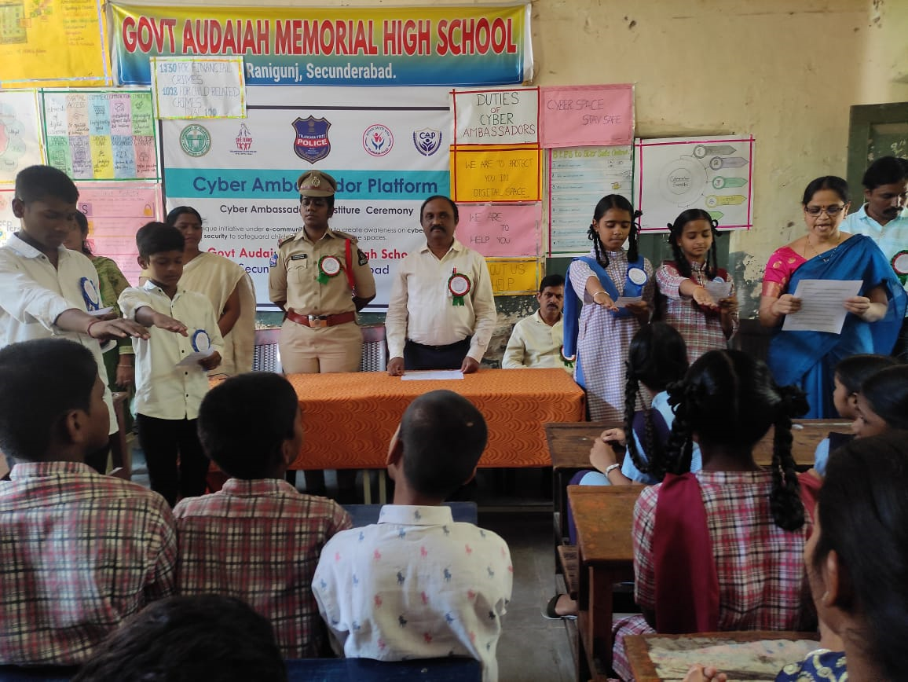

Slide 37
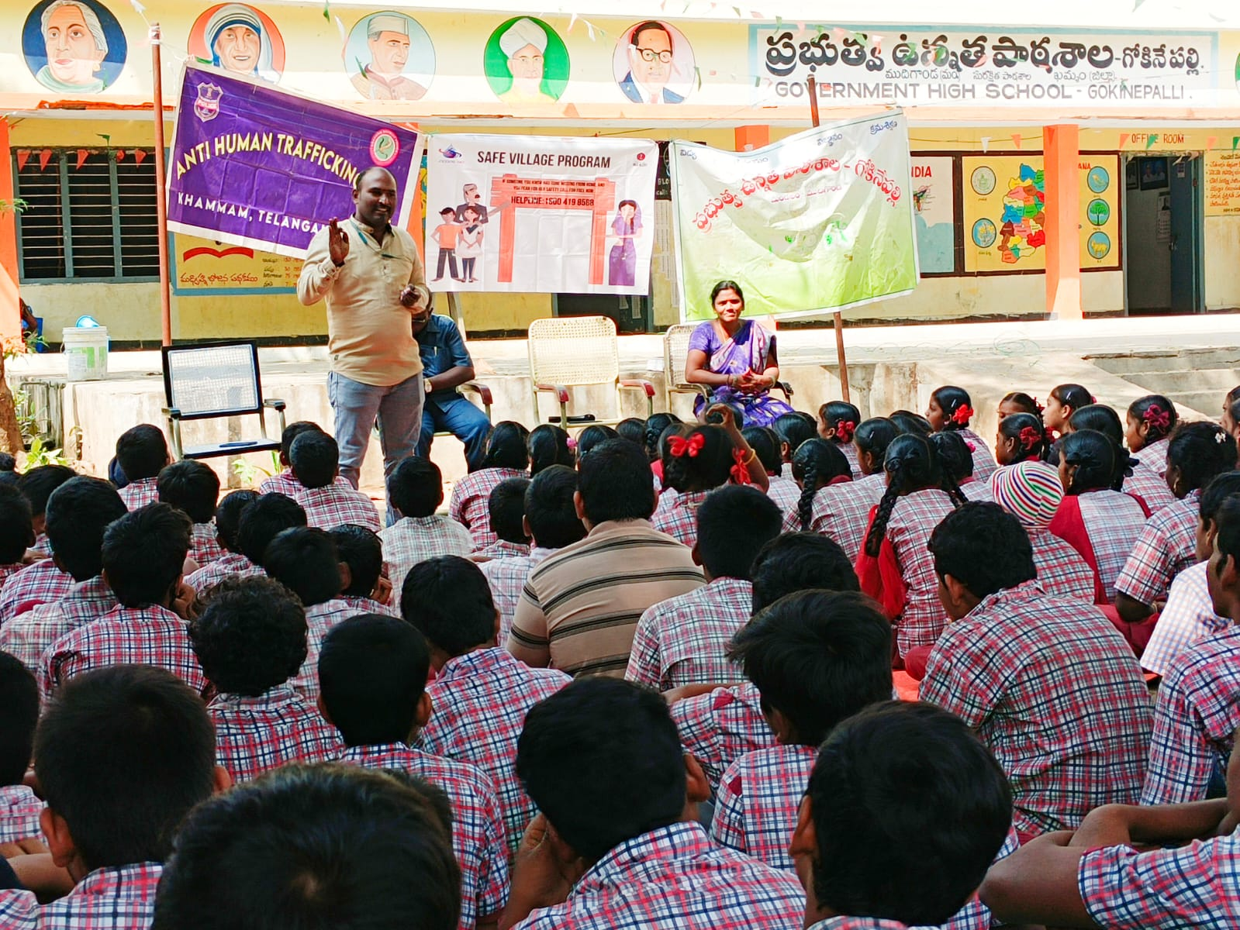
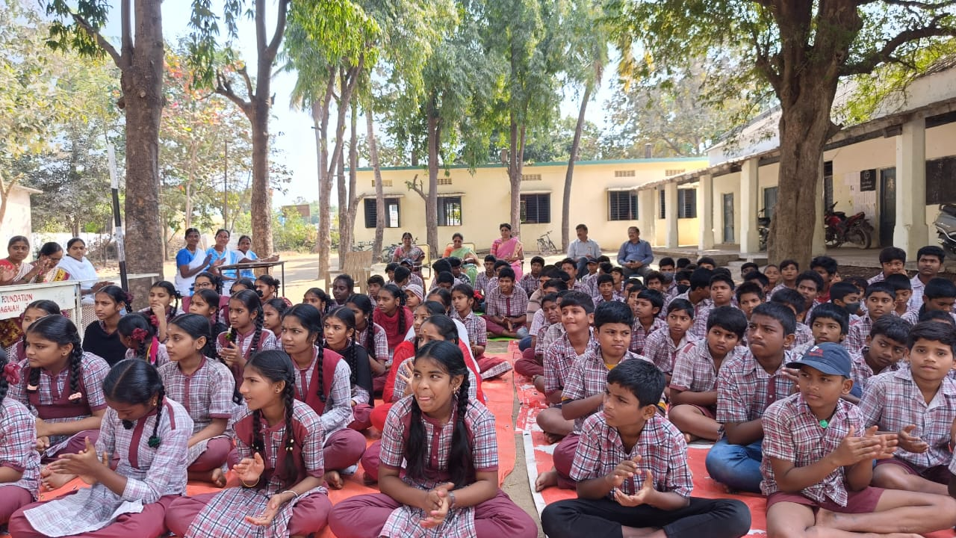
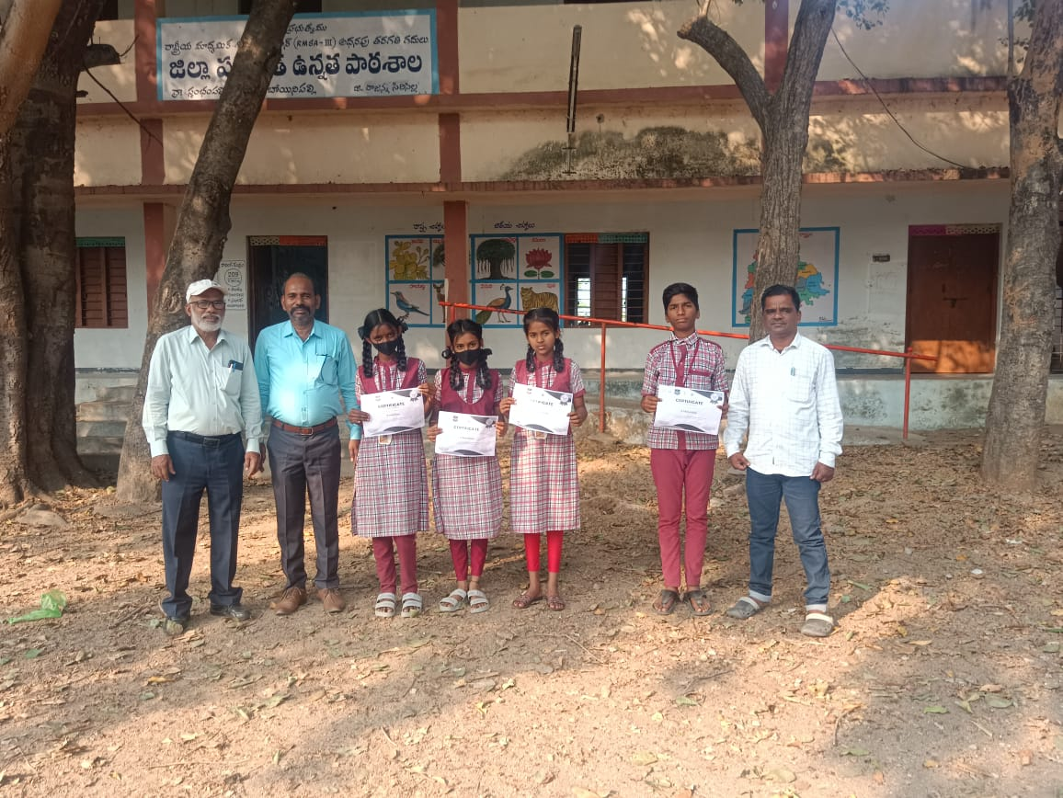

Slide 38
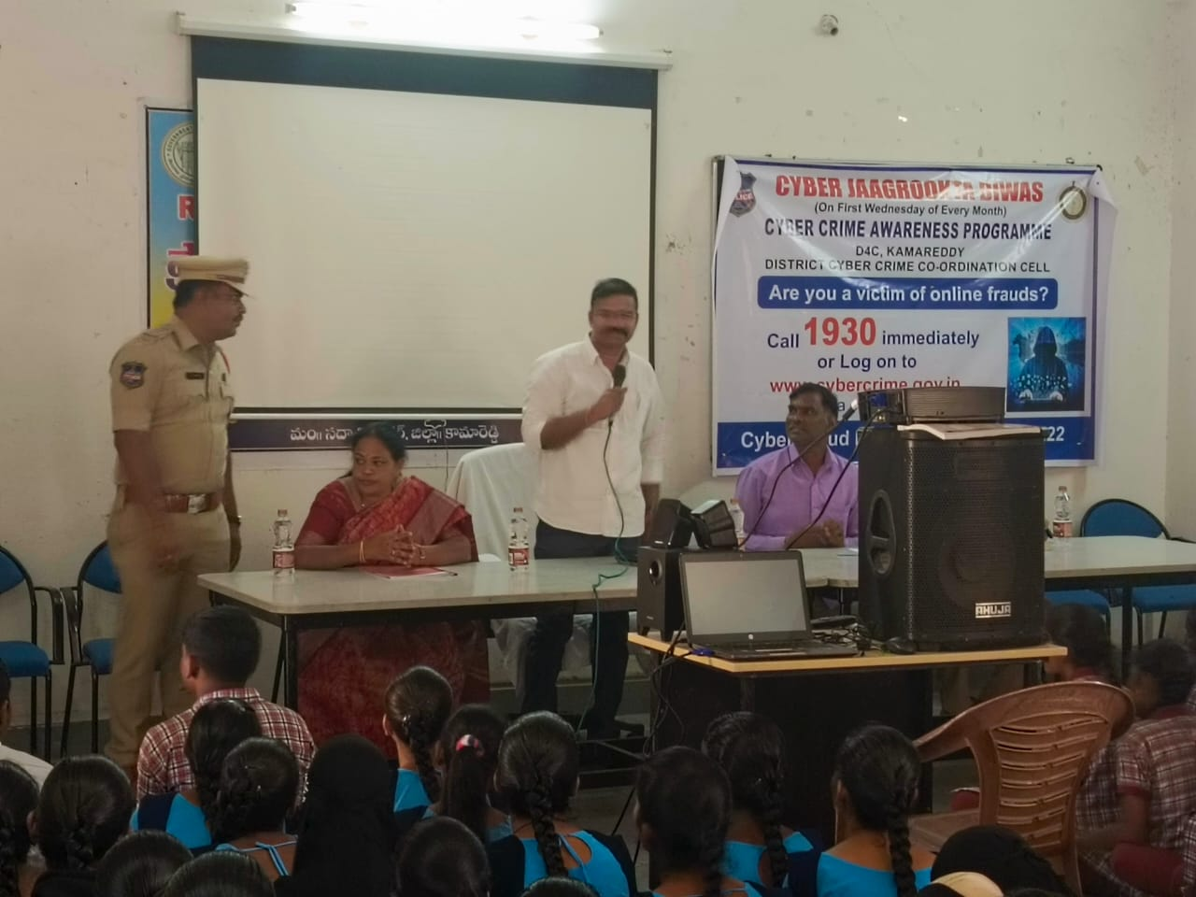

Slide 39
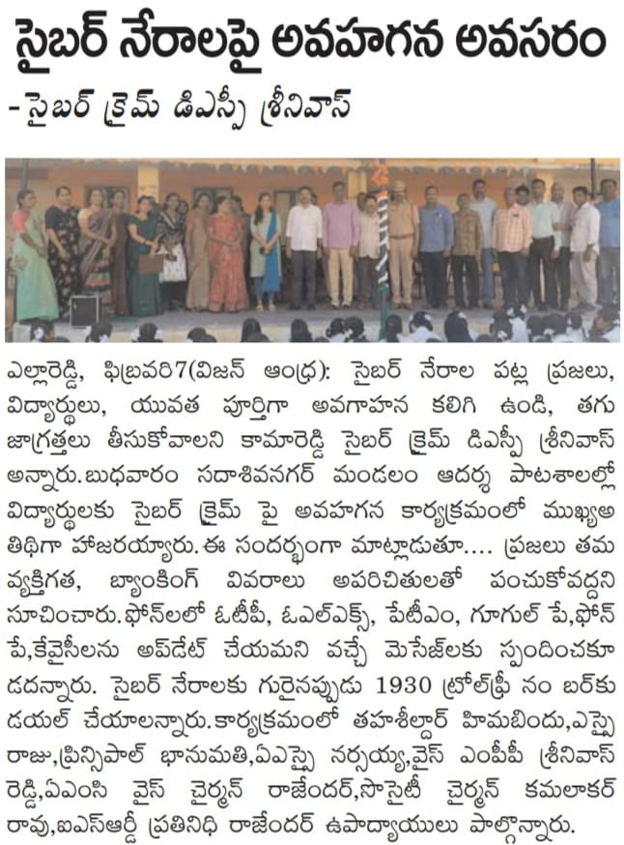
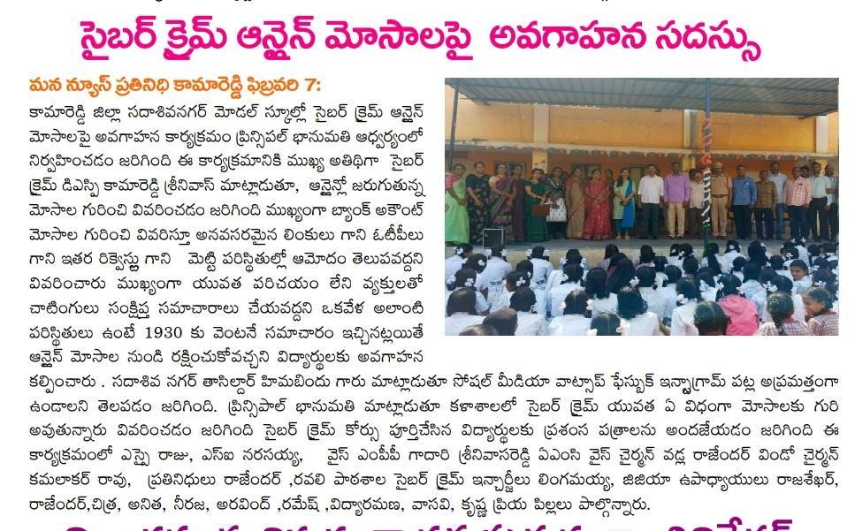
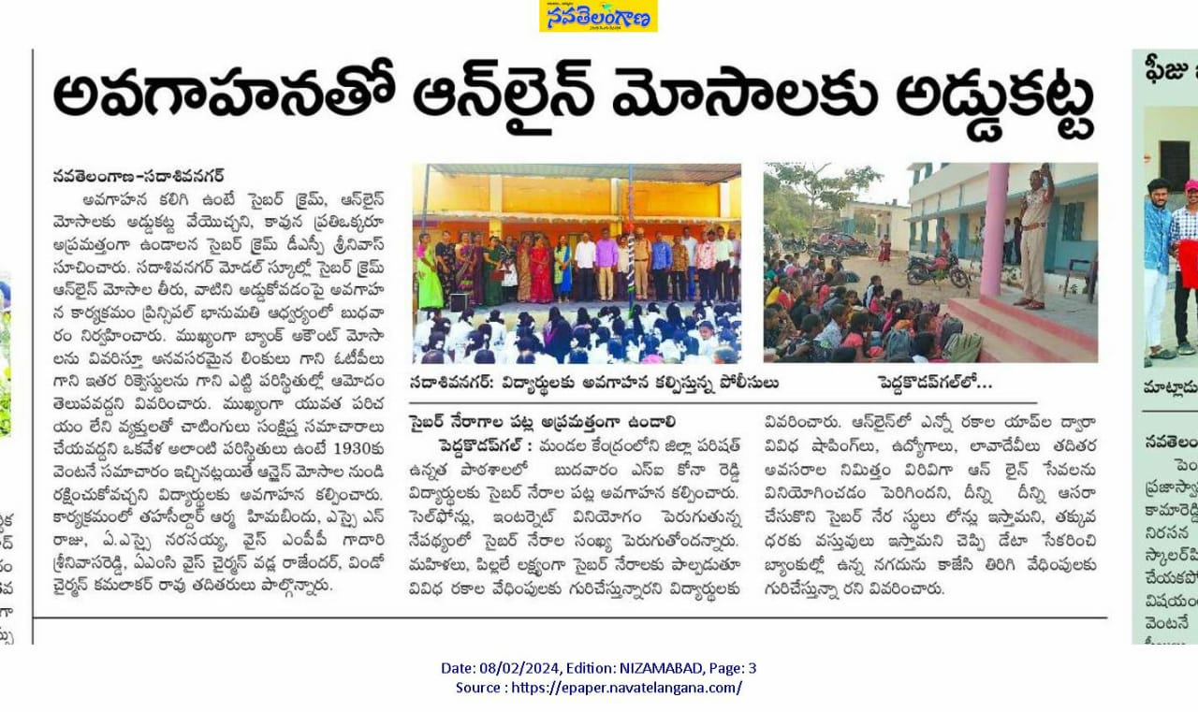

Slide 40
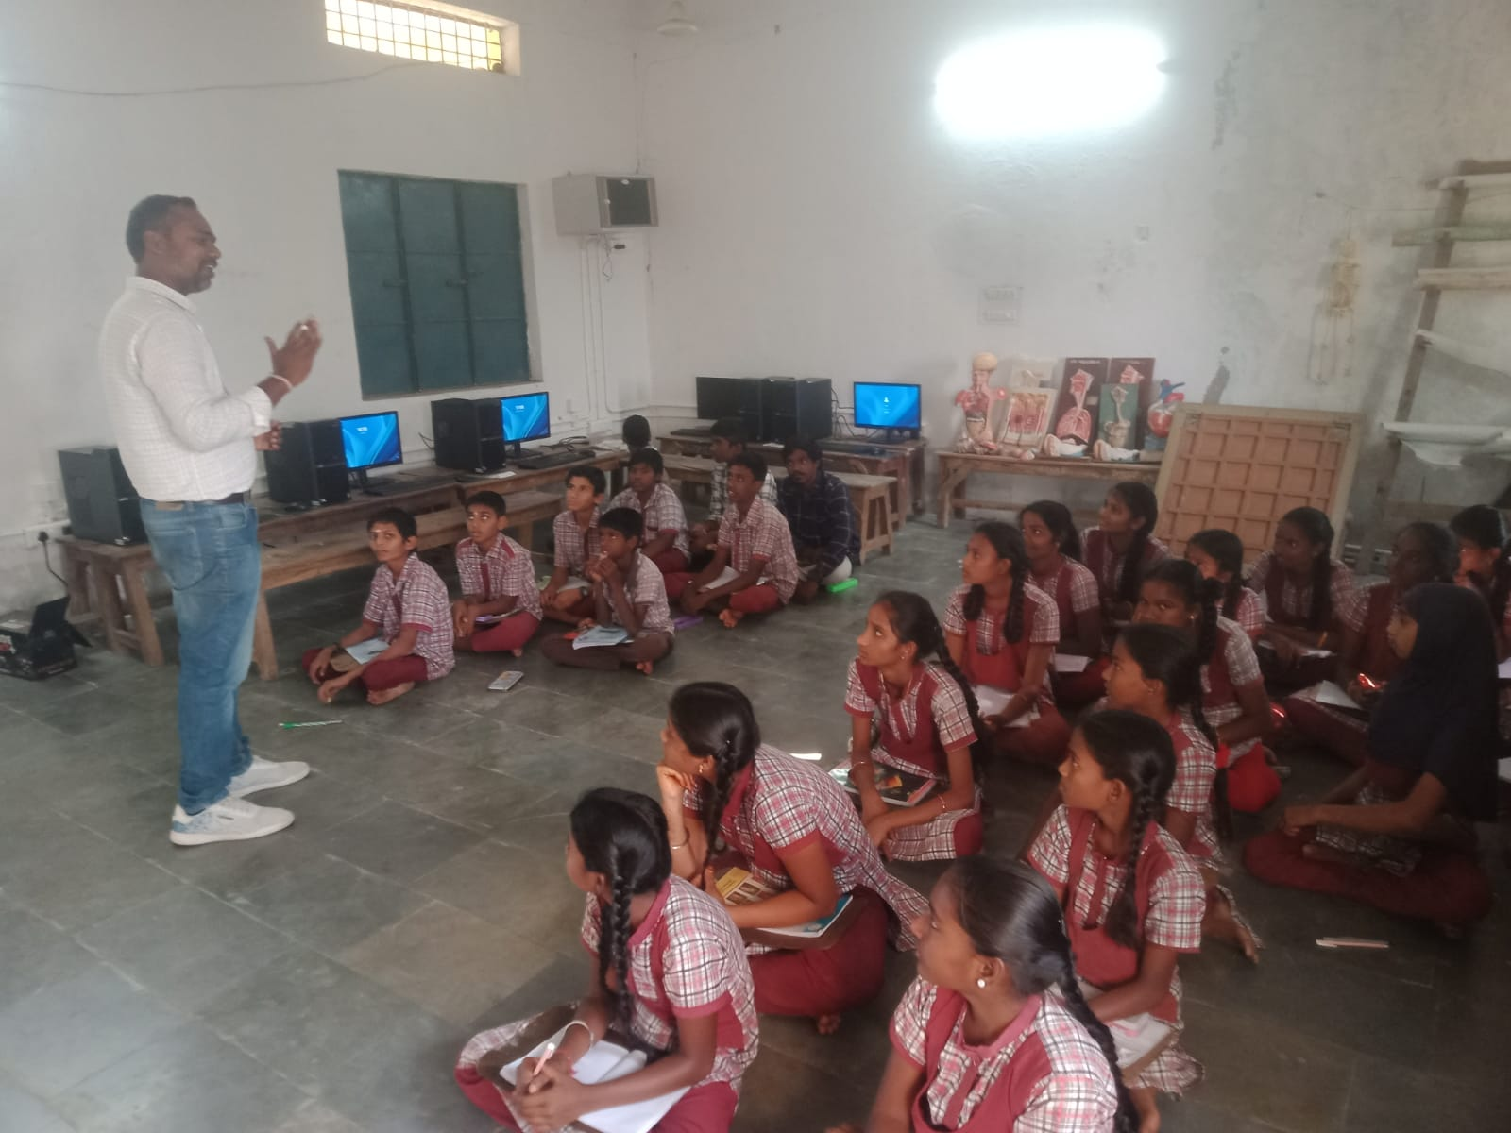
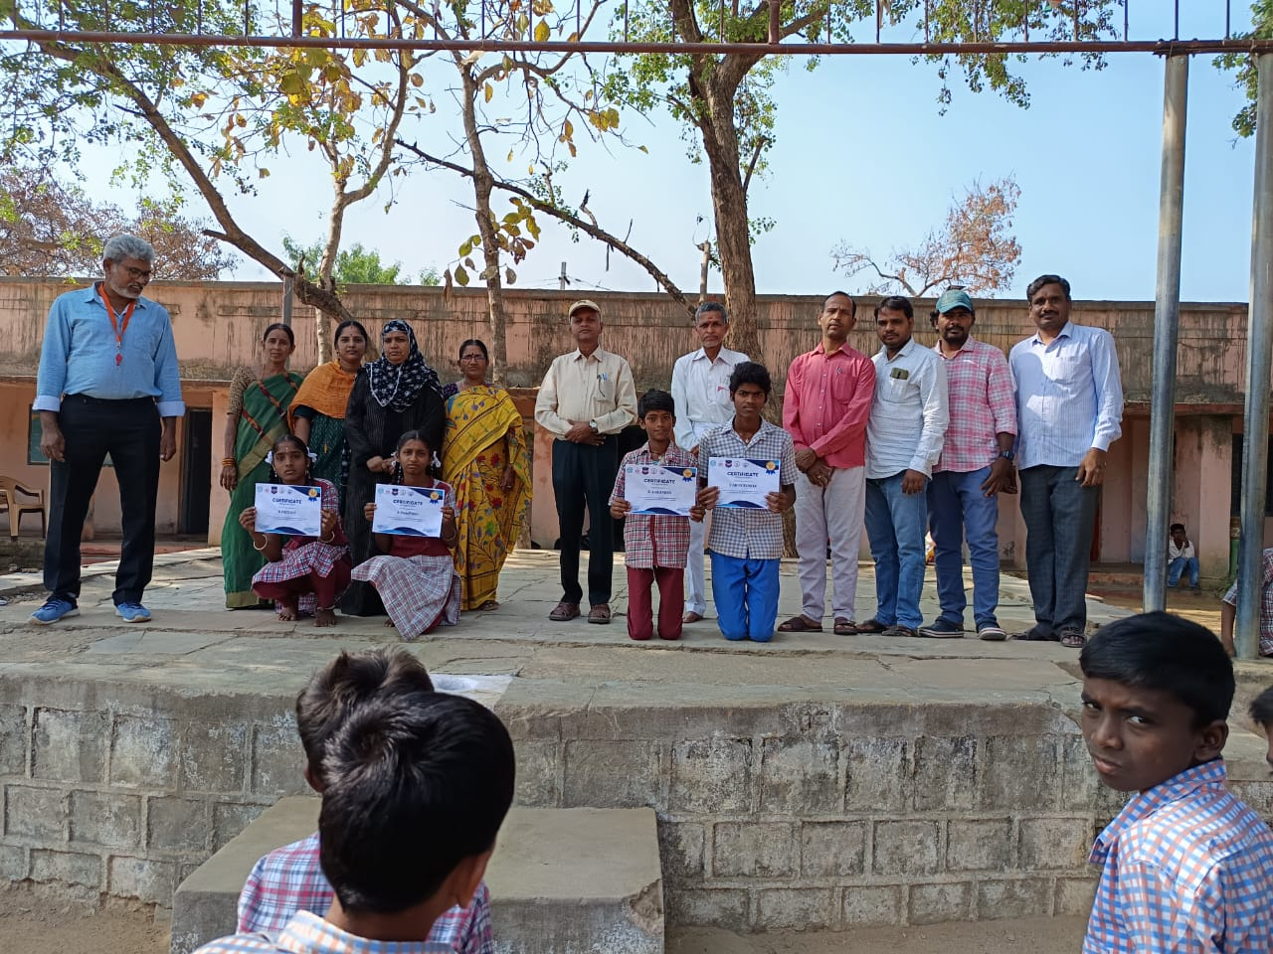
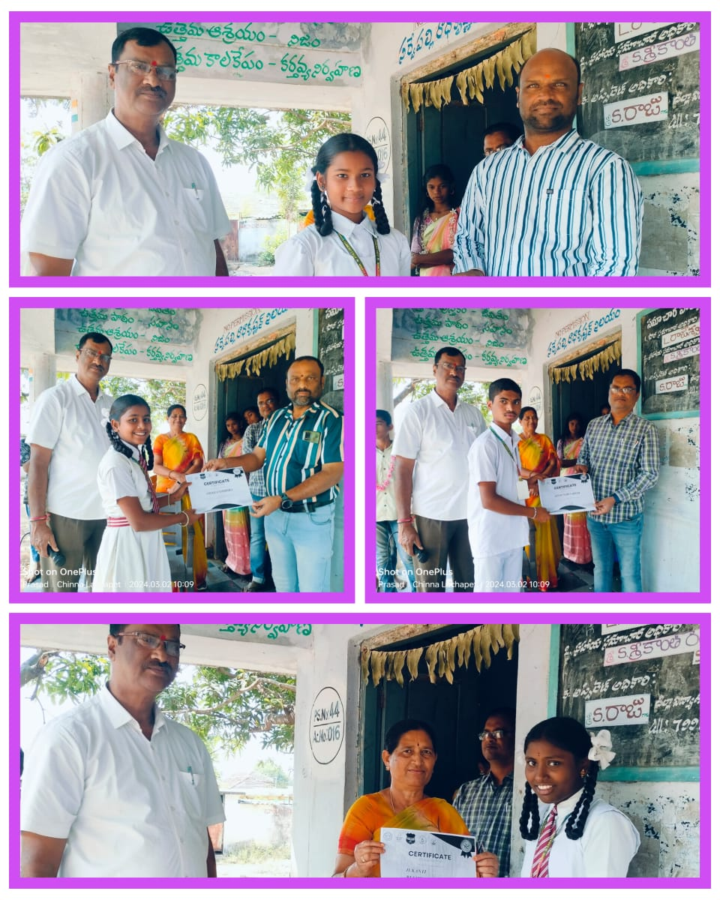
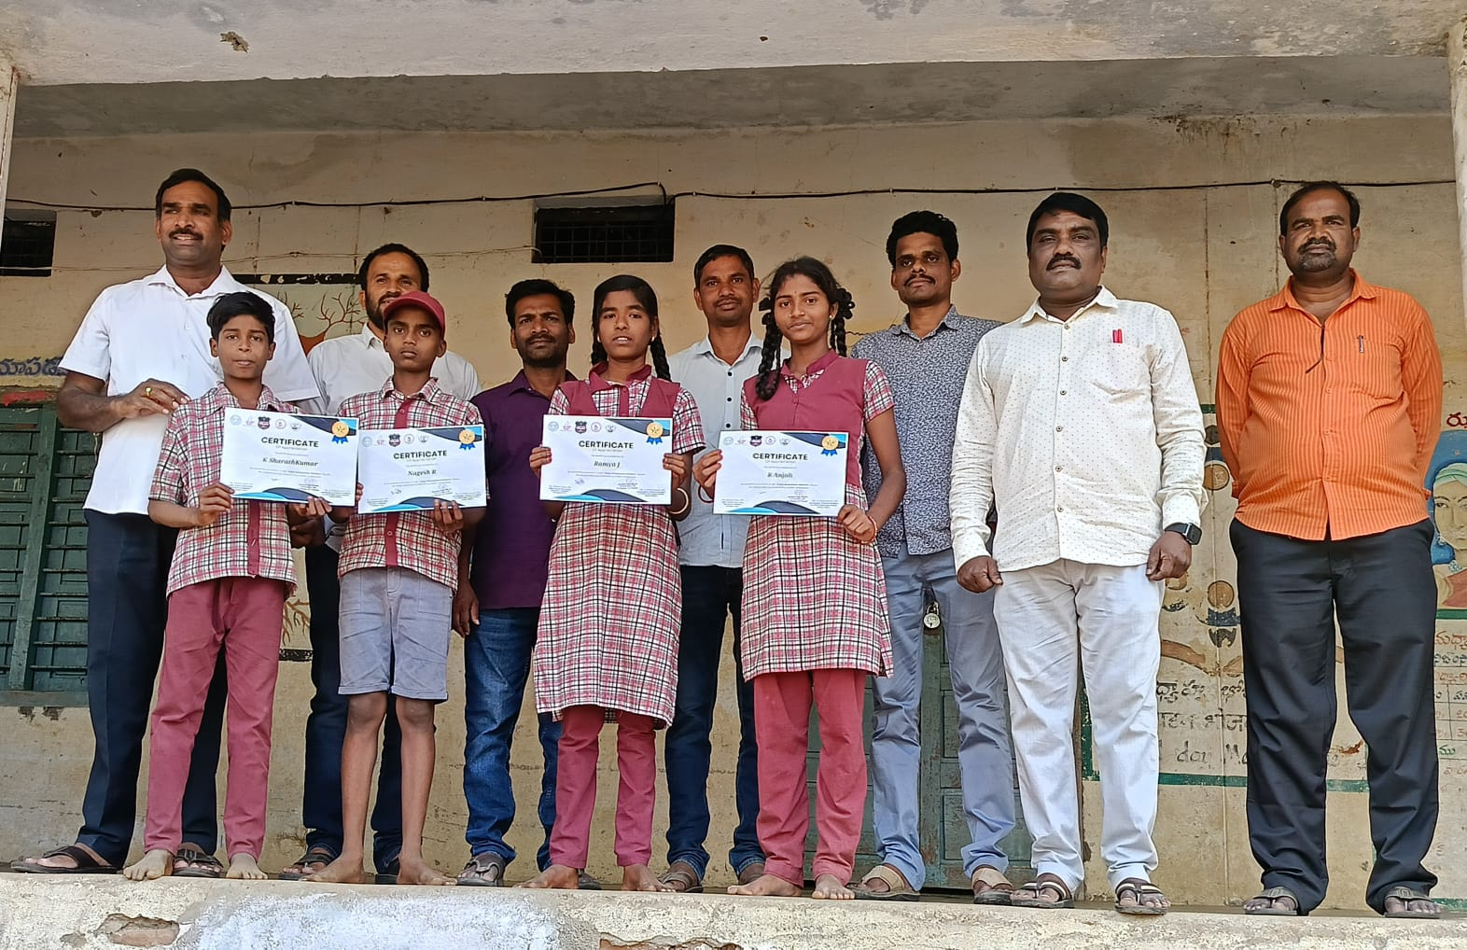
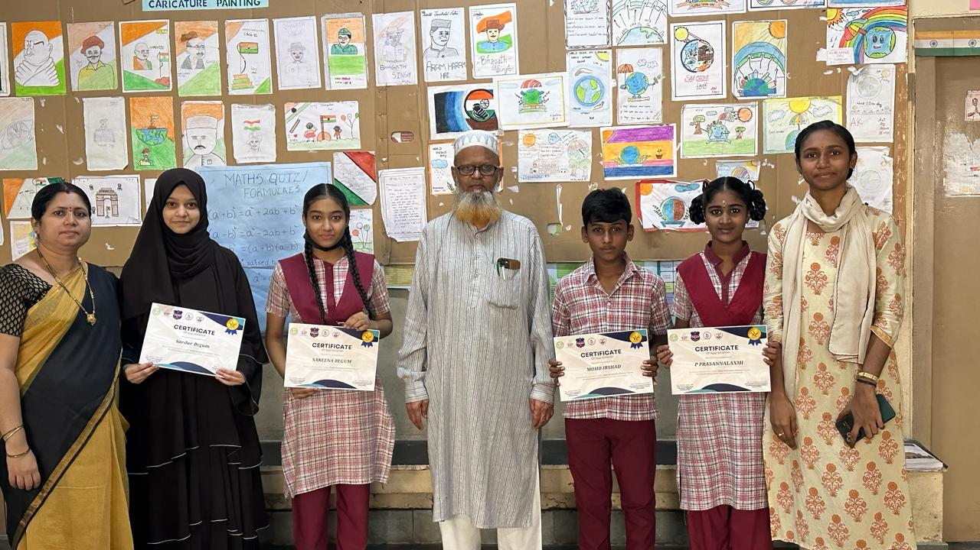
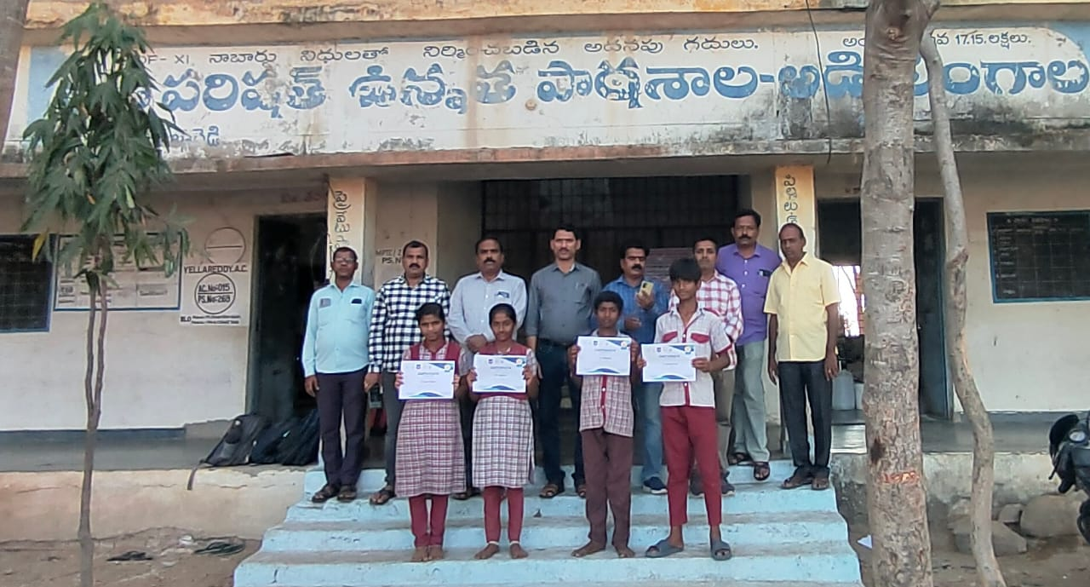

Slide 41
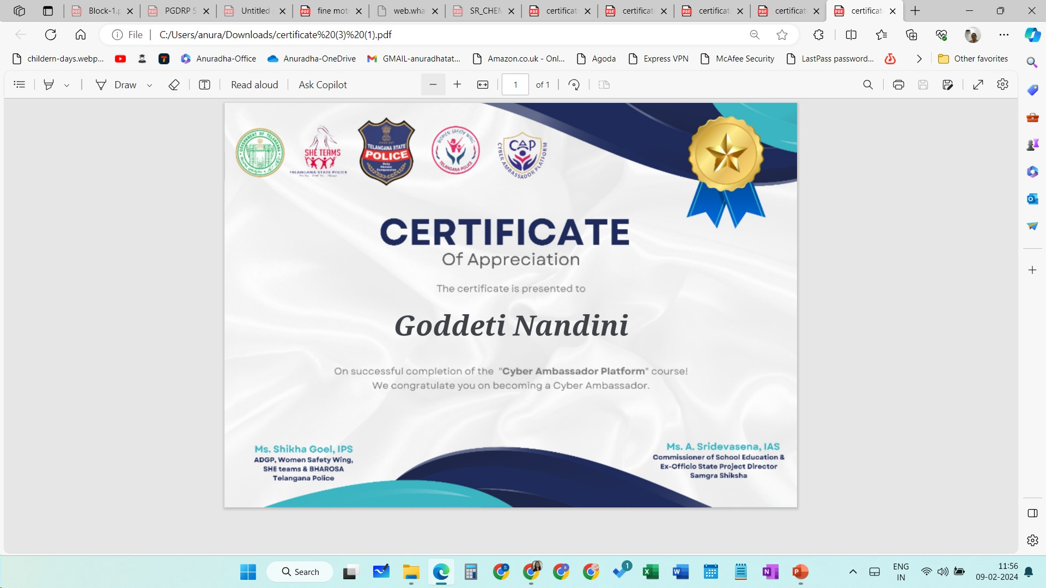

Slide 42
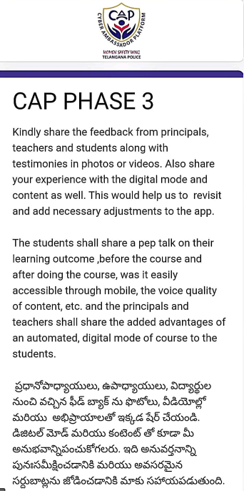
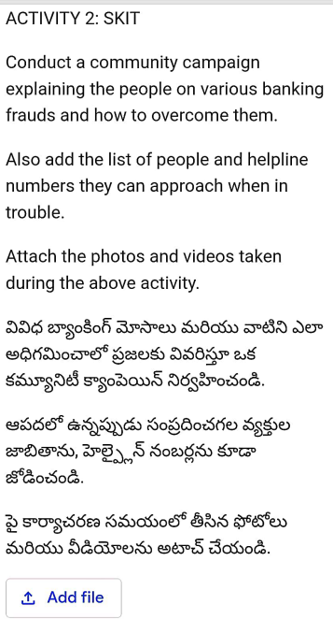
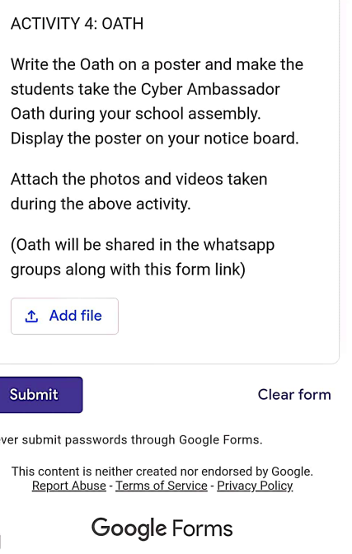

Slide 43



Slide 44

Get involved!

Slide 45


